Slide 1
Singleton and Flyweight pattern
Singleton pattern
Flyweight pattern
2018.08.23

Slide 2
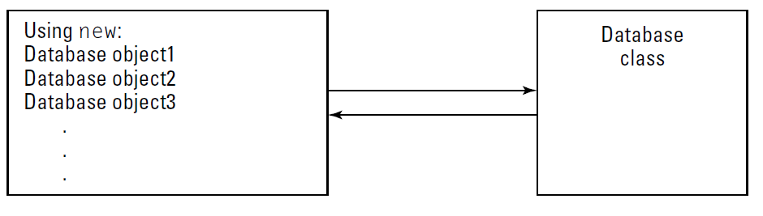
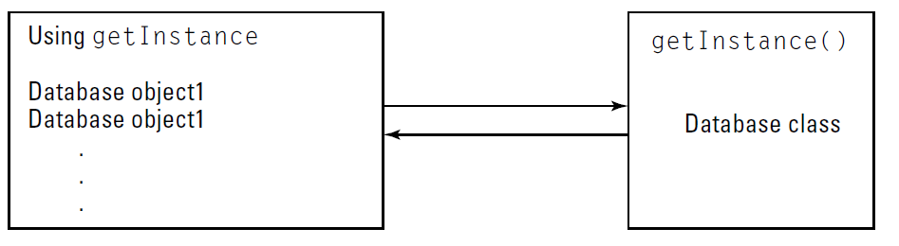
1. Singleton pattern
A. Using new to get object
B. Using getInstance to get object (Singleton)

Slide 3
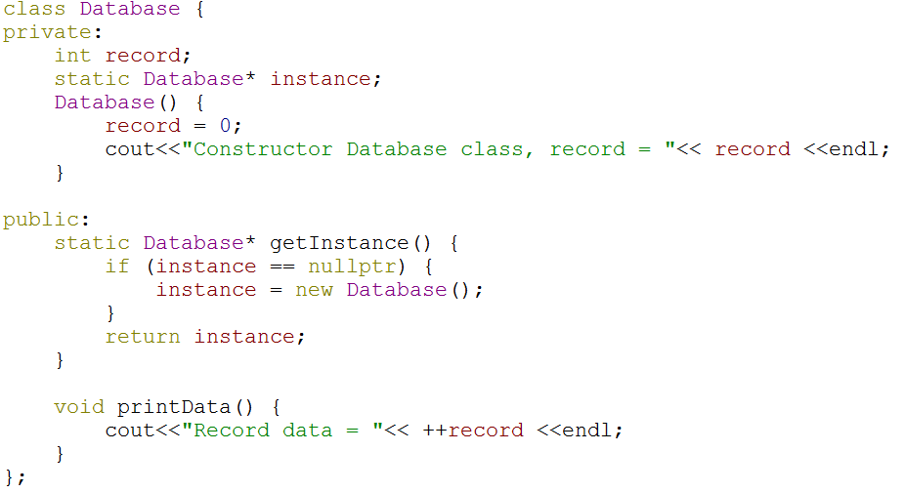
1.1 Singleton pattern implementation
Notes:
Một cách đơn giản nhất tạo ra class singleton.

Slide 4
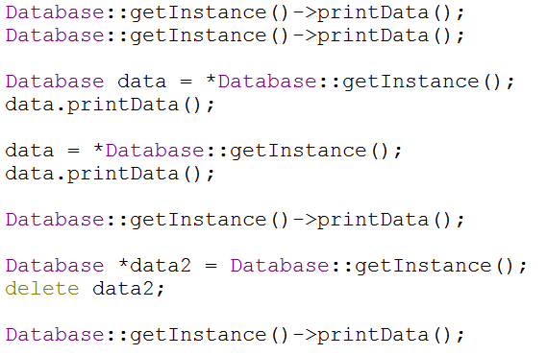
1.2 Singleton pattern not create once
Notes:
Tuy nhiên người dùng có rất nhiều cách dùng khác nhau

Slide 5
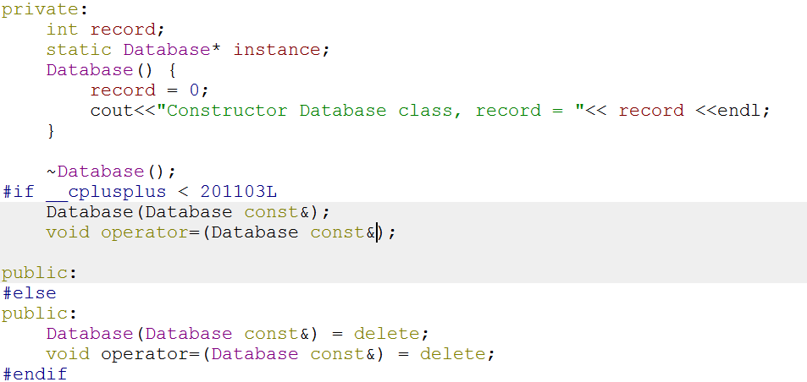
1.2 Fix singleton pattern not create once
Notes:
Bằng cách hide destructor method, copy constructor và oprator assignment. Hạn chế được việc tạo object.

Slide 6
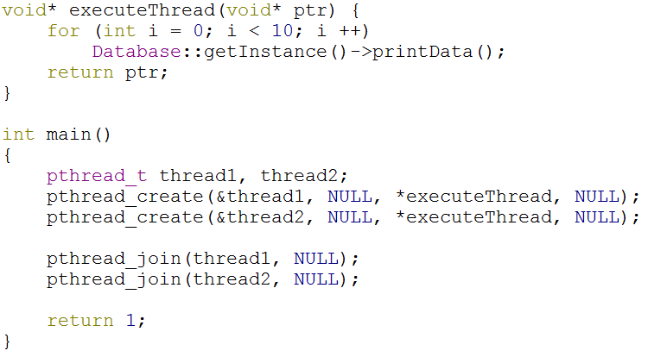
1.3 Singleton pattern not create once in multithread
Notes:
Trong khi sử dụng multi-thread. Singleton class đã tạo hơn 1 object.

Slide 7
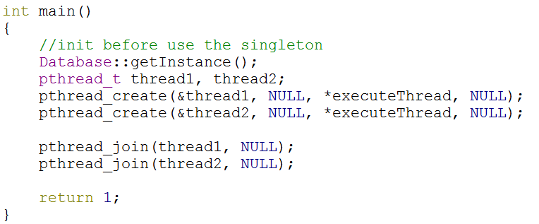
1.4 Approach to use singleton in multi-thread
Notes:
Create object when application starting up. Init time

Slide 8
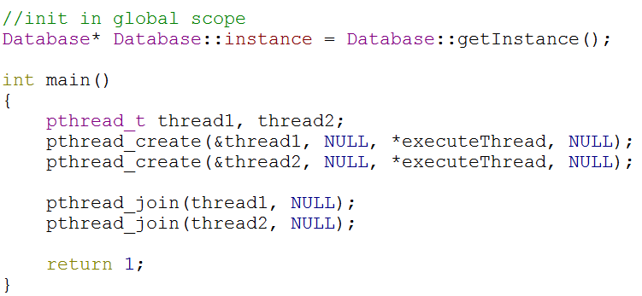
1.4 Approach to use singleton in multi-thread
Notes:
Create when application starting up, defining instance variable.

Slide 9
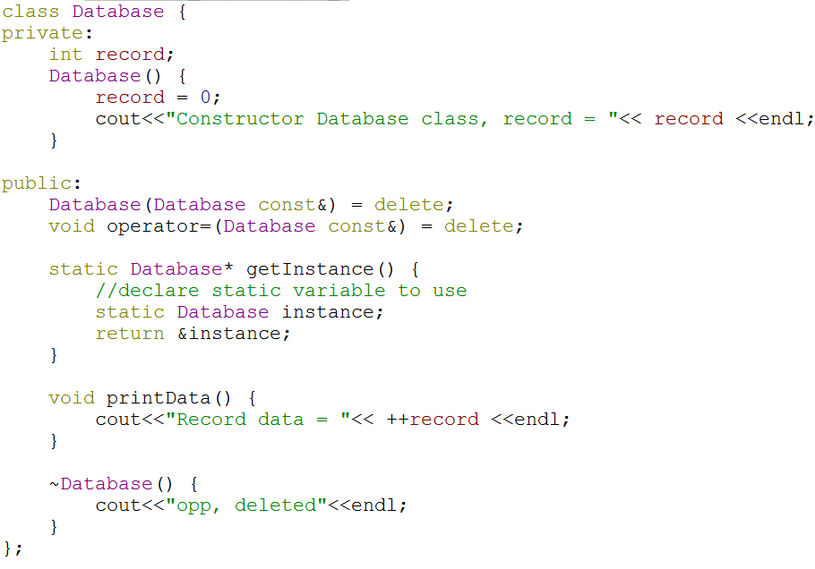
1.4 Approach to use singleton in multi-thread
Notes:
Use the static variable. Need move destructor to public and do not do anything.

Slide 10
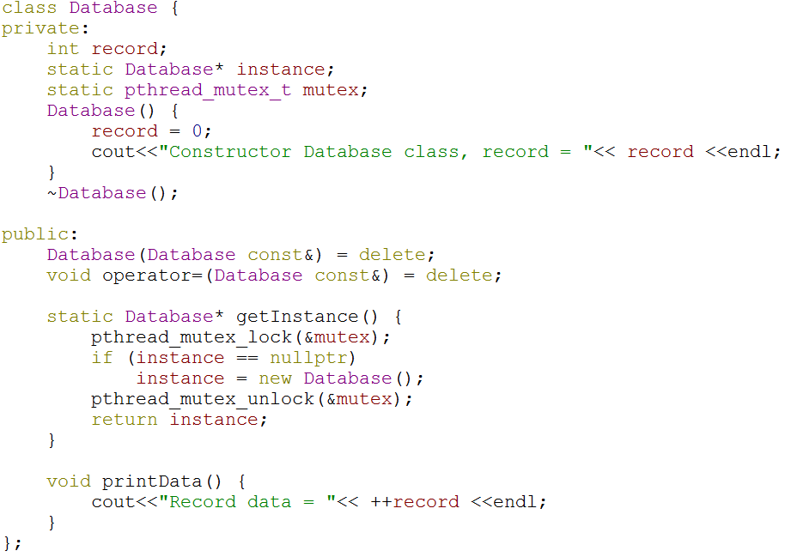
1.4 Approach to use singleton in multi-thread
Notes:
Use the mutex. It make access data slow than normal

Slide 11
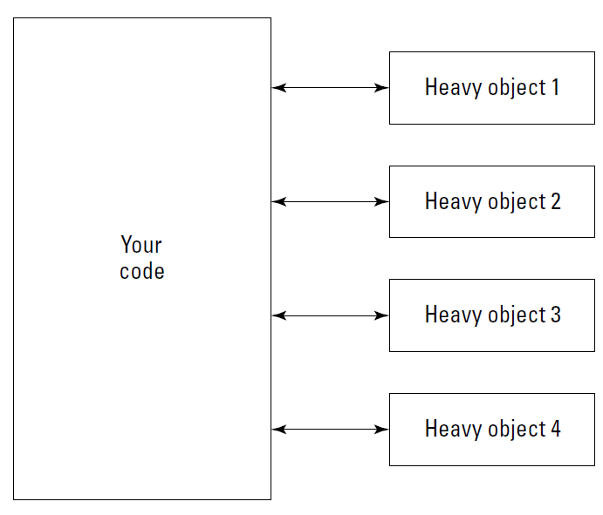
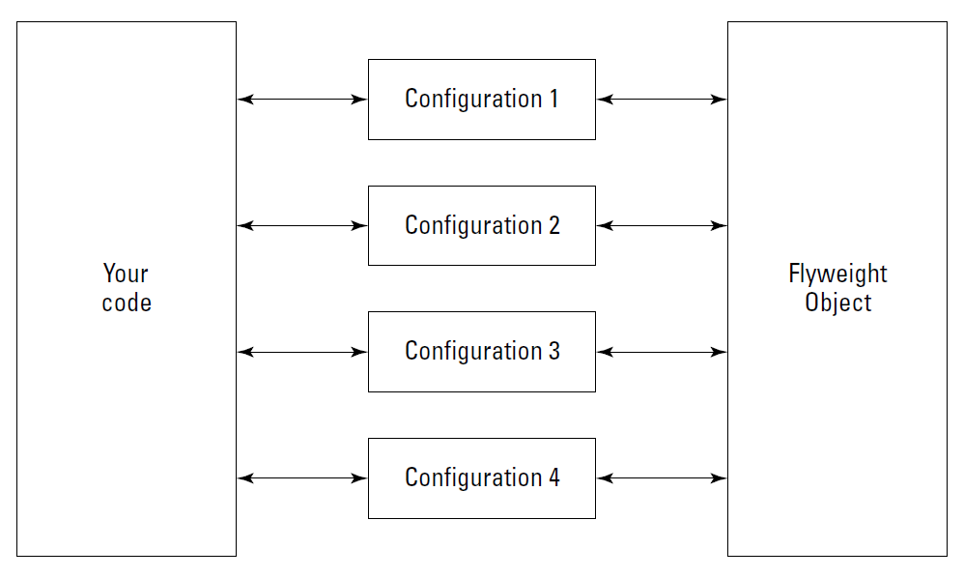

2. Flyweight pattern
A flyweight is a shared object that can be used in multiple contexts simultaneously. The flyweight acts as an independent object in each context — it’s indistinguishable from an instance of the object that’s not shared

Slide 12
2.1 Flyweight example
See source code

Slide 13
End…
Thank you!

